Slide 1
Predicting Hospital Readmissions for Diabetes Patients
David Sivieri
CSC8200 Health Informatics
Feb. 24, 2020

Slide 2
Project Background
In 2011 - 3.3 million adult 30-day all-cause hospital readmissions.
$41.3 billion in associated hospital costs.[3]
Researchers and data scientists are trying to find predictors of readmission rate
Goal is to use machine learning techniques to attempt to predict which diabetes patients will be readmitted with 30 days
Relevant to course because it makes use of a Cerner database (Health Facts database)
Warehouse of hospital electronic medical records

Slide 3
Why topic interest?
Recently took data science and machine learning courses
Developed interest in using machine learning in predictive analysis
Python code widely used in ML and data science applications
Area of predicting readmissions is an active area of study
Readmissions are penalized by Medicare
Hospitals have large incentives to reduce readmissions

Slide 4
Database Stats
Database of 101,766 encounters and 71,518 unique patients
55 Attributes
Examples: “A1C Result”, “Age”, “Number of Procedures”, etc
Only covers years 1999–2008
Encounters tagged ‘<30’, ‘>30’, ‘NO’
130 U.S. hospitals used [1]
Bed size of most hospital: 100 - 499 beds
Wide geographic distribution
Midwest (18 hospitals), Northeast (58), South (28), and West (16)

Slide 5
Data Selection Criteria
Inpatient encounter (a hospital admission)
“Diabetic” encounter
Some kind of diabetes was entered to the system as a diagnosis.
Length of stay - at least 1 day and at most 14 days.
Lab tests were performed during the encounter.
Medications were administered during the encounter. [1]

Slide 6
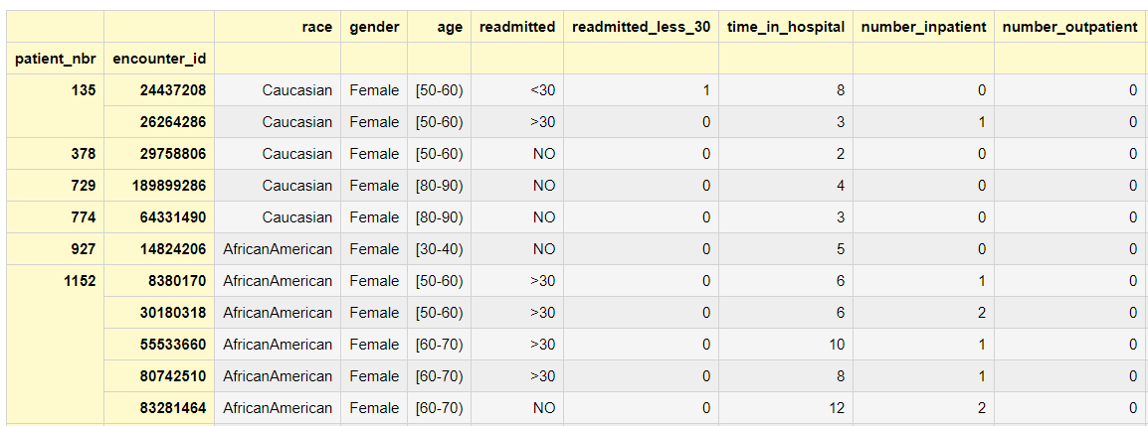
Important Fields

Slide 7
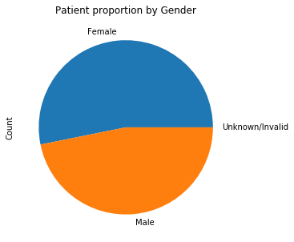
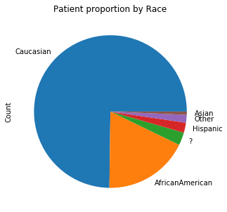
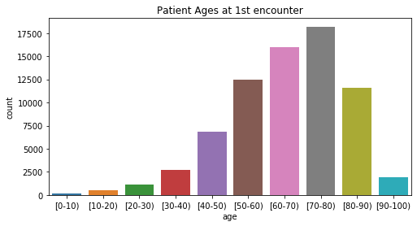
Patient Demographics

Slide 8
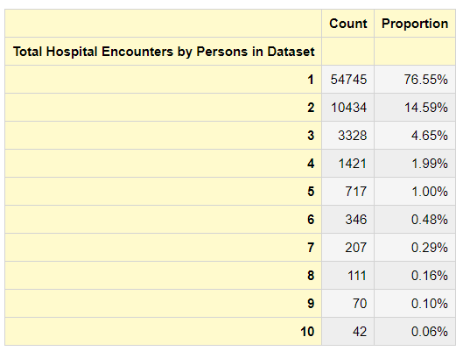
Hospital Utilization (over 10 years)
Over 90% of patients had 2 or fewer hospital encounters over 10 year database span

Slide 9
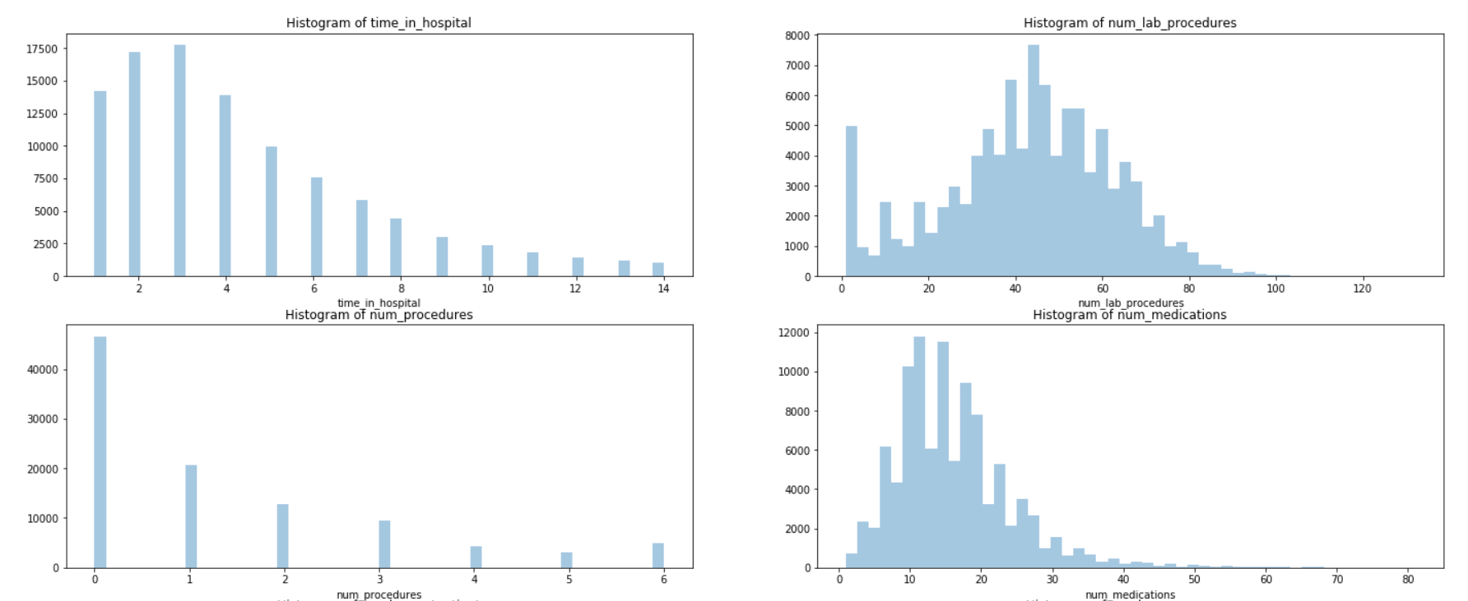
Histograms of Numeric Data

Slide 10
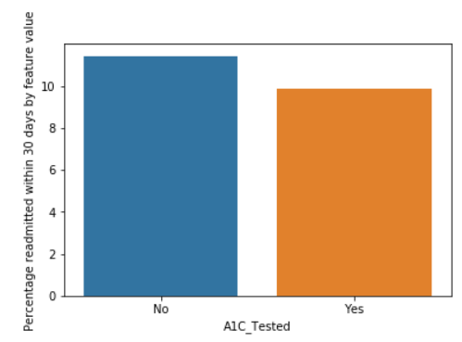
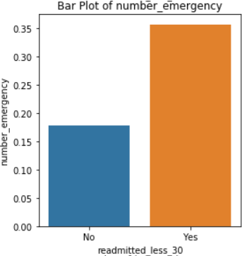
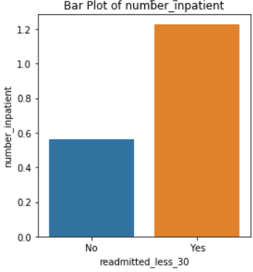
Avg. Differences in Readmission classes

Slide 11
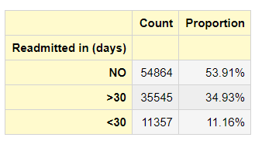
Machine Learning / Predictions
Used 2 ML algs – Decision Trees and Random Forests
Problem: Highly imbalanced data:
Models trained on unbalanced data – bias towards majority class
Solution
Undersample majority class when training
Oversample (using synthetic data) minority class

Slide 12
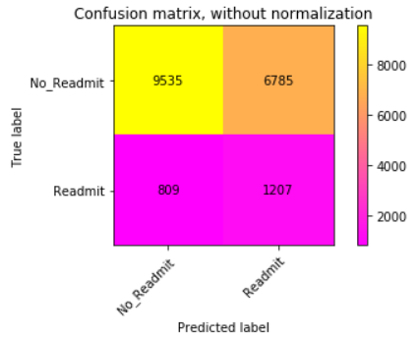
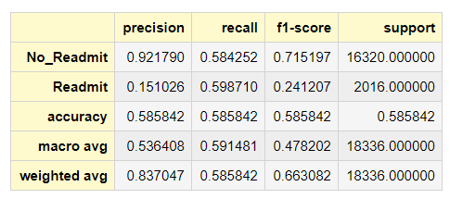
Undersampling Majority Class
Training Data Pre-Resampled: {0: 65331, 1: 8012}
Training Data Pre-Resampled: {0: 8012, 1: 8012}
Random Forest Accuracy: 58.58%

Slide 13
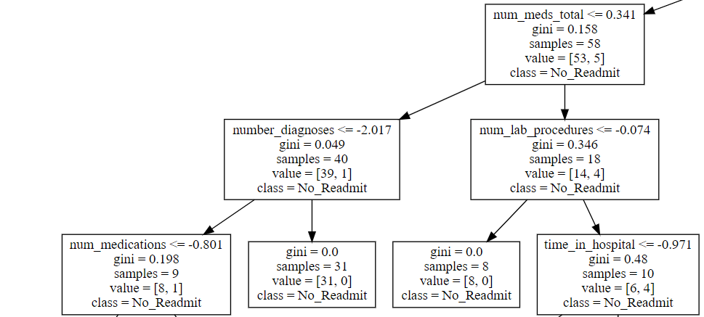
Decision Tree Example

Slide 14
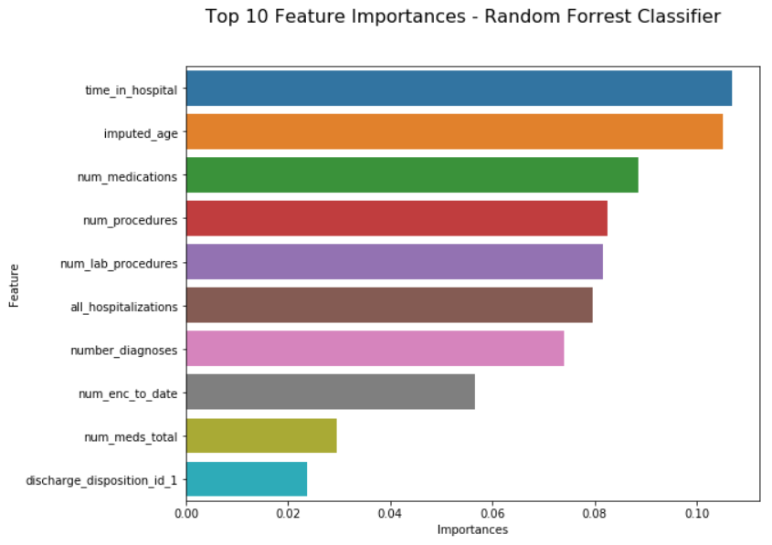
Feature Importances

Slide 15
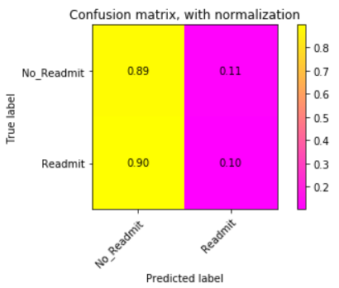
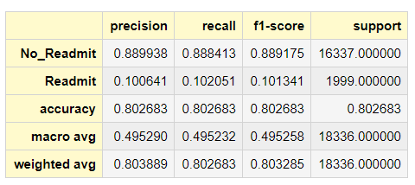
Dummy Classifier Baseline
Performs weighted guess biased towards training set class distribution
If 89% of training class is no_readmit, 89% of predictions will be no_readmit
80.1% Accurate

Slide 16
Challenges / Conclusions
Data is messy and has missing values
Needed more domain knowledge about hospital codes
Diagnosis code
Admission codes
Discharge codes
Creating predictive model seems difficult.
Not sure how useful even the best model created was.
More model refinements needed

Slide 17
References
[1] Beata Strack, Jonathan P. DeShazo, Chris Gennings, Juan L. Olmo, Sebastian Ventura, Krzysztof J. Cios, and John N. Clore. "Impact of HbA1c Measurement on Hospital Readmission Rates: Analysis of 70,000 Clinical Database Patient Records." BioMed Research International vol. 2014. Article ID 781670, 2014, https://www.hindawi.com/journals/bmri/2014/781670/ Accessed 23 Feb 2020.
[2] Raza, Usman. "How to use machine learning to predict hospital readmissions?" Berkley School of Information 2018, https://medium.com/berkeleyischool/how-to-use-machine-learning-to-predict-hospital-readmissions-part-1-bd137cbdba07 Accessed 23 Feb 2020.
[3] Lin, Singh, Kar, and Usman Raza. "What are Predictors of Medication Change and Hospital Readmission in Diabetic Patients?" Berkley School of Information 2017, https://www.ischool.berkeley.edu/projects/2017/what-are-predictors-medication-change-and-hospital-readmission-diabetic-patients Accessed 23 Feb 2020.
[4] "Diabetes 130-US hospitals for years 1999-2008 Data Set" UCI Machine Learning Repository https://archive.ics.uci.edu/ml/datasets/diabetes+130-us+hospitals+for+years+1999-2008# Accessed 23 Feb 2020.

